Slide 1
EPS Final Design
Solar panel hold down and release mechanism
Solar panel deployment
Pointing driver
Bus regulation
Battery

Slide 2
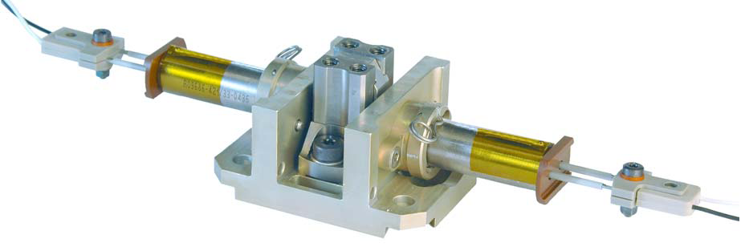
Hold down and release mechanism
DutchSpace Thermal Knife
Dyneema wires
“Cutting” by thermal knife
Low shocks
High reliability

Slide 3
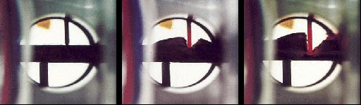
Hold down and release mechanism

Slide 4
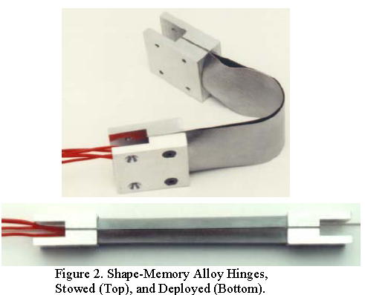
Solar panel deployment
Use of smart
memory alloys
High reliability
No pyrotechnic
shocks

Slide 5
Pointing driver
To fully point solar panels towards the Sun
Driven by stepper motor
Increased accuracy by using gear head

Slide 6
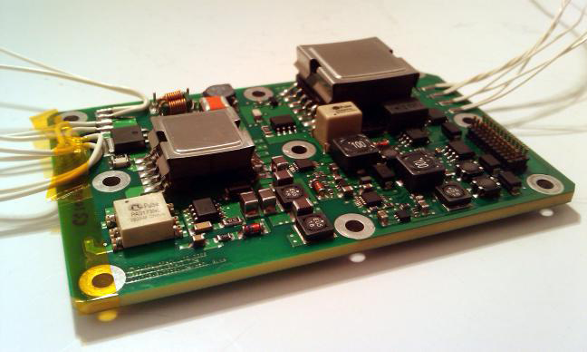
Bus regulation: DC/DC convertor

Slide 7
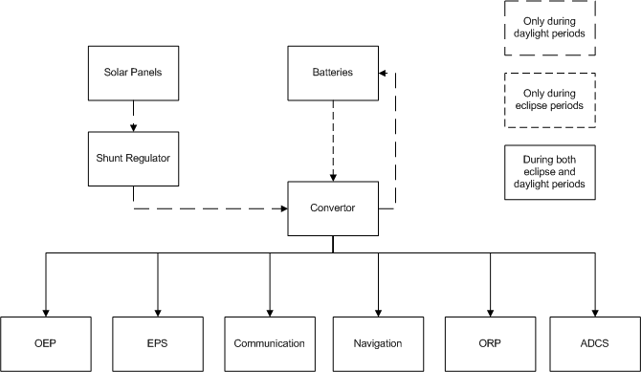
Bus regulation: electrical block diagram

Slide 8
Battery
Lithium-ion cells
158 Wh/kg
Module consists of 7 cells connected in series
Battery consists of 2 modules connected in parallel
28 Vdc at 6Ah
1 battery for the receivers, 3 for the emitter

Slide 9
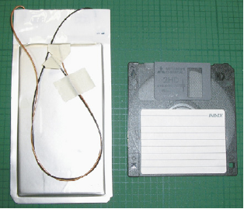
Battery

